Slide 2


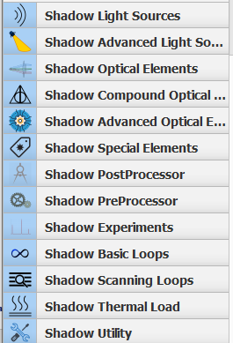
Modelling synchrotron radiation beamlines with
OASYS
Transport of photons in a Beamline
Manuel Sanchez del Rio
srio@esrf.fr
Advanced Analysis & Precision Unit, MEG/ISDD, ESRF
March 15th & 17th 2022
shadowOui

Slide 3
Transport of power in a Beamline
Outline:
Introduction to ray tracing
Simulation of a beamline:
Undulator Source
Mirror focusing (KB): size at sample
Effect of aberrations
Source dimensions
Double-crystal monochromator
Energy resolution
Crystal coupling: (+,-) (+,+)
Flux and power that arrive to the sample
shadowOui

Slide 4
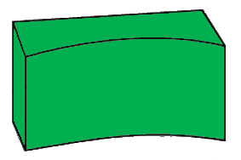
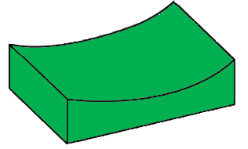
Photon transport on a beamline
Optical components that could be present in a beamline:
Focusing system
Front end
Primary slits
Monochromator
Source
Sample
KB mirrors
Water-cooled
slits
Primary mirrors
Windows

Slide 5
Mirror focusing and aberrations

Slide 6
Mirror errors

Slide 7
Monochromator

Slide 8
Full beamline

Slide 9
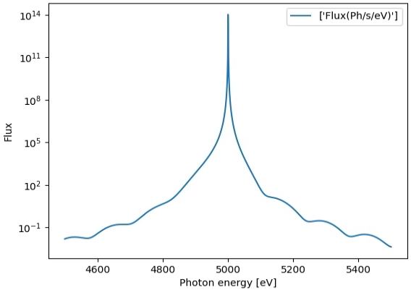
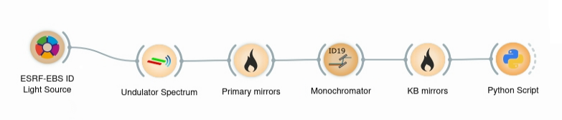
Calculation of flux at the sample position
Optical components that could be present in a beamline:
KB slits
51 m
Front end
Primary slits
Monochromator
Focusing system
Source
Sample
KB mirrors
Primary mirrors
Water-cooled
slits
8.4x10¹³ ph/s
5 KeV

Slide 10
More…
Additional slides

Slide 11
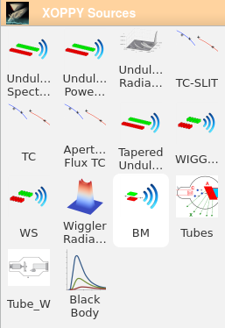
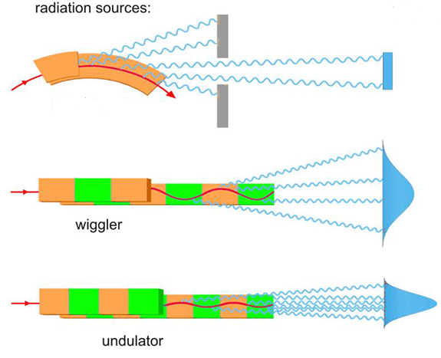
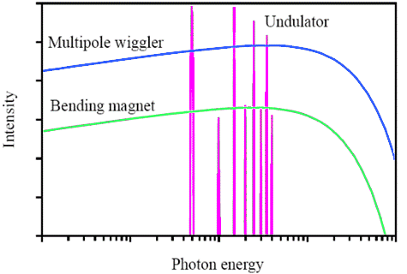
Simulation of source emission
Source spectrum (Photon flux or power vs Energy)
XOPPY
Undulator
Wiggler
bending magnet
Bending
magnet

Slide 12
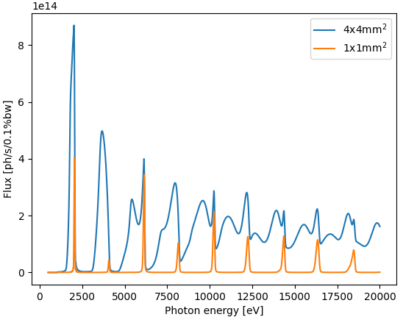
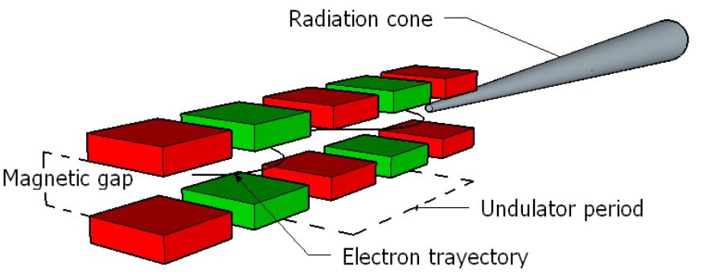
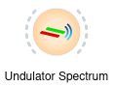
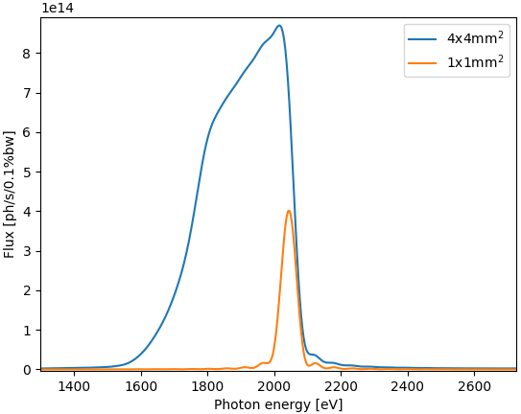

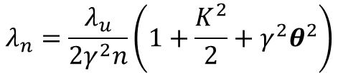
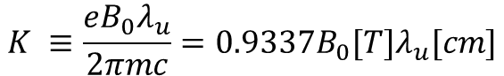
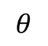
Undulator emission simulation
XOPPY
$$K ≡\frac{eB_{0}λ_{u}}{2πmc}=0.9337B_{0}[T]λ_{u}[cm]$$
$$λ_{n}=\frac{λ_{u}}{2γ^{2}n}\left(1+\frac{K^{2}}{2}+γ^{2}θ^{2}\right)$$
Slit
U42
$$θ$$
30 m

Slide 13
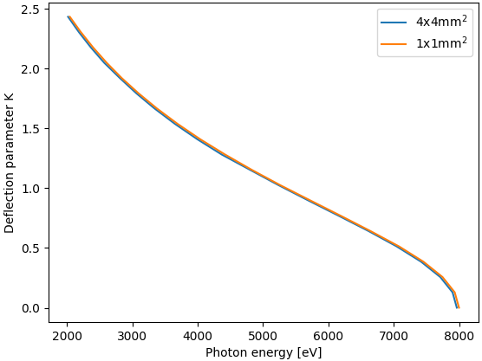
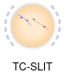
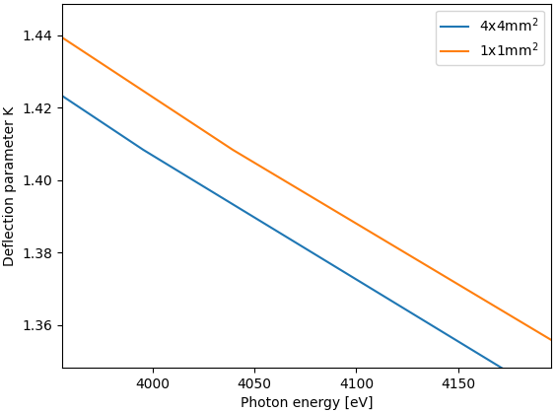
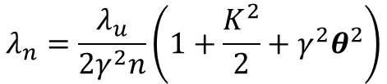
Undulator emission simulation
XOPPY
1st harmonic
$$λ_{n}=\frac{λ_{u}}{2γ^{2}n}\left(1+\frac{K^{2}}{2}+γ^{2}θ^{2}\right)$$
~50 eV
U42
Slit
$$θ$$
30 m

Slide 14
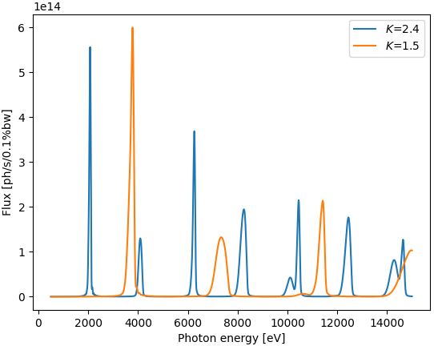

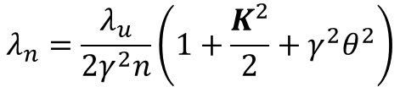
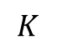
Undulator emission simulation
XOPPY
$$λ_{n}=\frac{λ_{u}}{2γ^{2}n}\left(1+\frac{K^{2}}{2}+γ^{2}θ^{2}\right)$$
U42
$$K$$

Slide 15
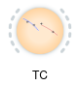
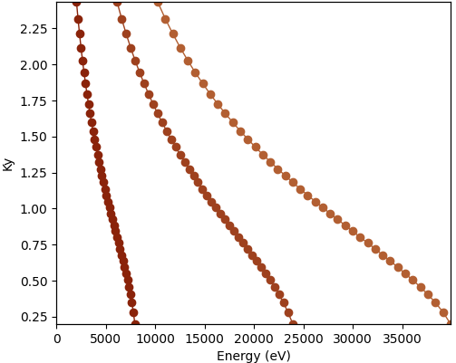
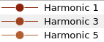
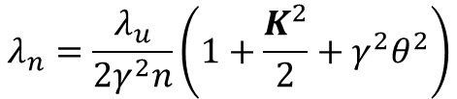
Undulator emission simulation
XOPPY
$$λ_{n}=\frac{λ_{u}}{2γ^{2}n}\left(1+\frac{K^{2}}{2}+γ^{2}θ^{2}\right)$$
U42
$$K$$

Slide 16
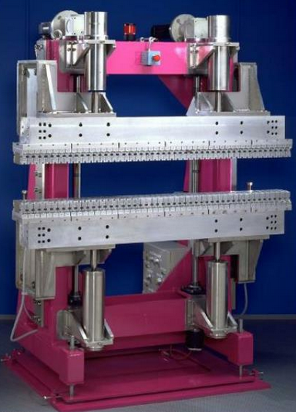

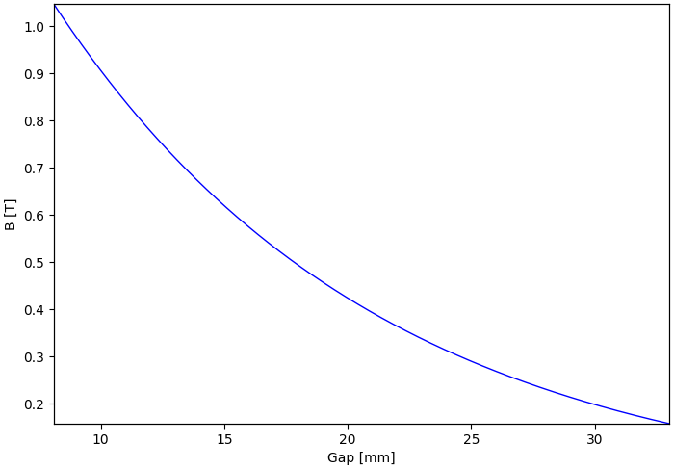
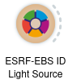
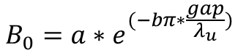
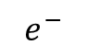
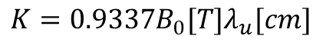
Undulator emission simulation (gap)
$$e^{−}$$
Gap
$$K=0.9337B_{0}[T]λ_{u}[cm]$$
$$B_{0}=a∗e^{(−bπ∗\frac{gap}{λ_{u}})}$$

Slide 17
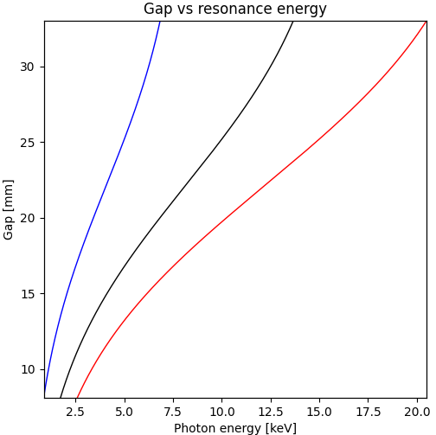
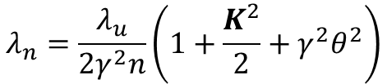
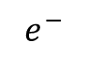
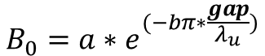
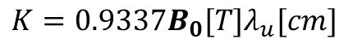
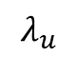
Undulator emission simulation
$$e^{−}$$
Gap
$$λ_{u}$$
Reducing
the gap
incrementing K
larger wavelength
$$B_{0}=a∗e^{(−bπ∗\frac{gap}{λ_{u}})}$$
$$K=0.9337B_{0}[T]λ_{u}[cm]$$
$$λ_{n}=\frac{λ_{u}}{2γ^{2}n}\left(1+\frac{K^{2}}{2}+γ^{2}θ^{2}\right)$$

Slide 18
Simulation of source emission
Undulator power density (power vs x, y)
Undulator spectral flux density (flux/power vs x, y, E)
Wiggler spectral flux density (flux/power vs x, y, E)

Slide 19
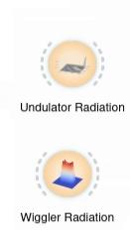
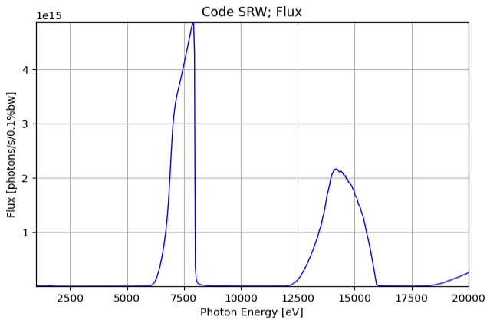
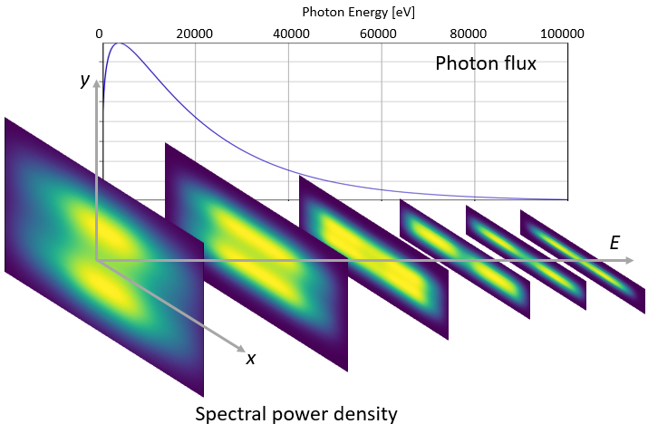
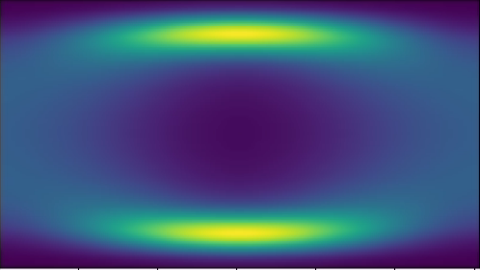
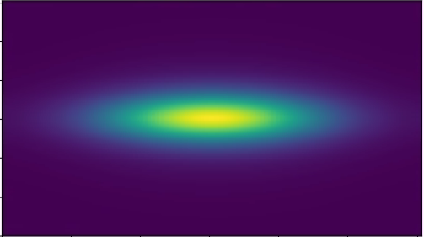
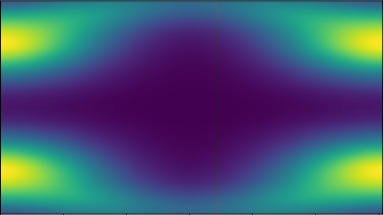
Simulation of source emission
Undulator spectral flux density
(flux/power vs x, y, E)
Wiggler spectral flux density
(flux/power vs x, y, E)
Photon Energy [eV]
1000 5000 10000 15000 20000
y
Photon flux
E
x

Slide 20
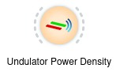
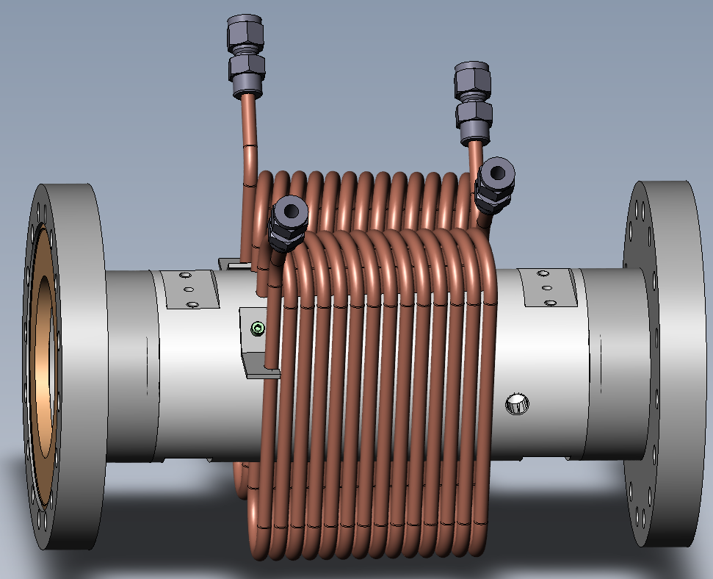
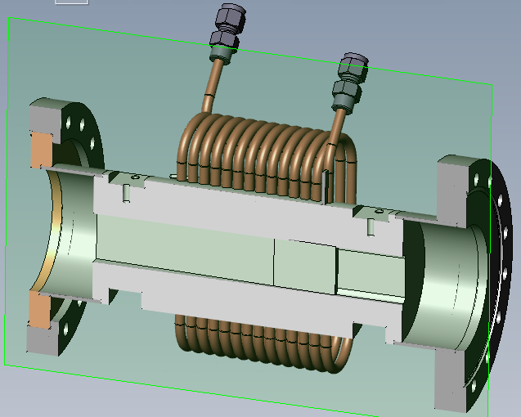
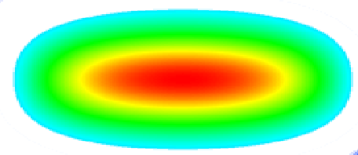
Undulator power density (Power vs x, y)
For example, this tool is very useful to get the heat load on a slit:
Water cooled beamline slit
undulator

Slide 21
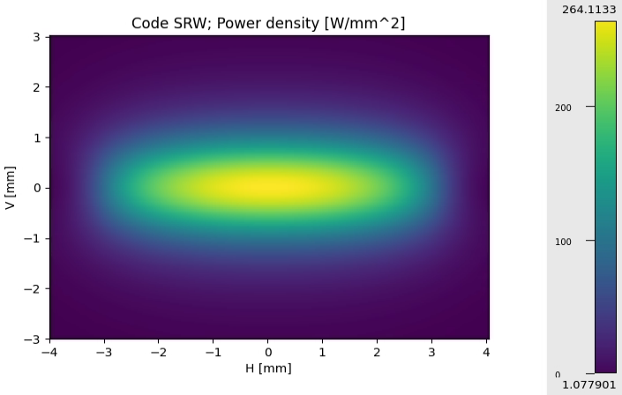
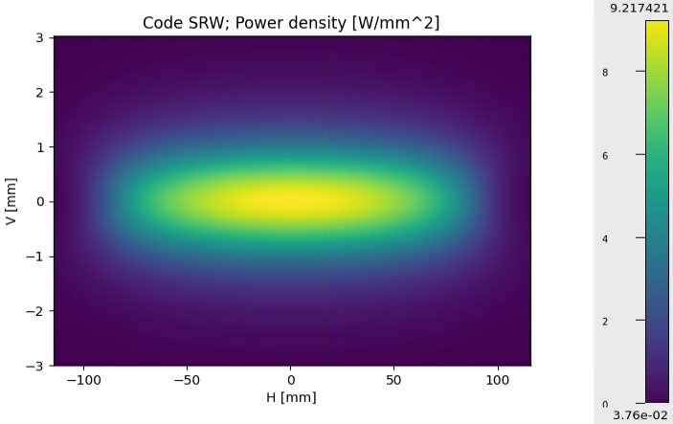

Undulator power density (Power vs x, y)
In most of the beamlines at the ESRF the are horizontal slits at 16 m from the source:
Perpendicular to the beam
Project over the slit surface (2º angle)
X-ray beam
Finite element analysis

Slide 22

Power transport on a beamline
Optical components that could be present in a beamline:
Focusing system
Front end
Primary slits
Monochromator
Source
Sample
KB mirrors
Water-cooled
slits
Primary mirrors
Windows
Slit 1
Aperture (a)
Source
Projected size at
downstream element (A)
Distance from the source (d)
Distance from the source (D)
$$A= \frac{D}{d}a$$

Slide 23



Filter (window) absorption
Filters of different thickness
Filters of different materials

Slide 24



Power absorbed by a filter
Heat load on filters @ 23 m with a projection of 2 mm x 1 mm:
U42-EBS
thickness
Material | Thickness [μm] | Absorbed Power [W]
Be | 300 | 19
Diamond | 300 | 40
X-ray beam
material & density

Slide 25



Power absorbed by a filter
Heat load on filters @ 23 m with a projection of 2 mm x 1 mm:
Be (300 μm)
Diamond (300 μm)

Slide 26
Power transport on a beamline
Optical components that could be present in a beamline:
Focusing system
Front end
Primary slits
Monochromator
Source
Sample
KB mirrors
Water-cooled
slits
Primary mirrors
Windows
Absorption by filters
Slit 1
Aperture (a)
Source
Absorption power by mirror

Slide 27


Mirror absorption
Same material, different angles
Same angle, different coatings

Slide 28




Mirror absorption
1st Harmonic
Example of reflection, primarily mirrors @ 30 m
Absorbed power 113 W
1st Harmonic
3rd Harmonic
3rd Harmonic
Absorbed power 52 W

Slide 29


Power absorbed by a mirror
Heat load on mirrors @ 30 m:
Si (7 mrad)
Diamond (100 μm) + Rh (3 mrad)

Slide 30






Other optical elements in XOPPY
Multilayers
[W(2.5)/Si(2.5)]₅₀
1.4º
$${mλ =2d}_{M}senθ\sqrt{1−\frac{2\overline{δ}}{{sen}^{2}θ}}$$

Slide 31

Other optical elements in XOPPY
[W(2.5)/Si(2.5)]₁₀
Multilayers

Slide 32





Other optical elements in XOPPY
Crystals
Bragg or reflection
Laue or transmission
Si (111)
10 keV

Slide 33


Other optical elements in XOPPY
Crystals
Rocking curve
Si (111)
22 keV

